Slide 1


TUTELAGE

Slide 2


PROBLEM STATEMENT
Solve lack of alumni tracking and poor alumni interaction among students who have graduated from educational institutions across Odisha.

Slide 3

Content
Meet the team
Introduction
Implementation
The Nucleus Application Group Synthesis
Our future scope
01
02
03
04
05
06
07

Slide 4
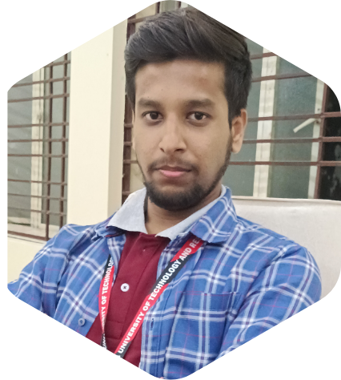
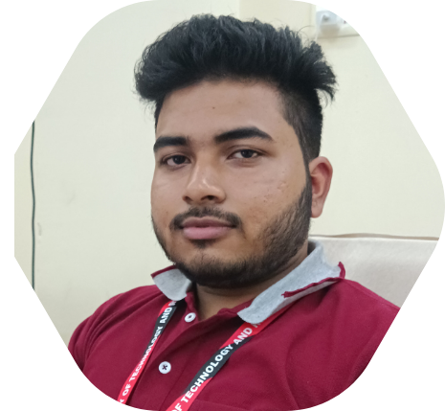
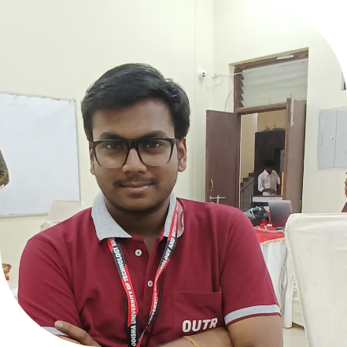
Meet the team
SHUBHARANSHU CHOWDHURY
SOMYA PRAKASH
HANS UPADHYAY

Slide 5
Introduction
1. The website will be able to keep Information of students who have cleared 10th, 12th, graduate, post graduate, and doctorate degrees will be captured through our website.
2. It will be a Single, bi-lingual platform for the alumni to register and facilitate interaction among the alumni as well as with their alma mater.

Slide 6
IMPLEMENTATION
Goal 1
To provide the user the language in which he/She is comfortable . but here we are just bound to a particular region so we will keep Odia and English language. And the native language will help the user to have an easy conversation .
Goal 2
The education system with the curriculum of the and the schemes which were currently running under the Government will be shown in our home page.
Goal 3
The page further will consist of the following:-
i.) Anganwadi/Rural Education system.
ii.) Specialty of Odisha education system
iii.) Progress of education in Odisha.
iv.) Educational admission procedure of Odisha .
This page will consist the approach to the solution of the problem statement .

Slide 7


NUCLEUS
It will help the user to chat with the alumunis of the respective educational institutions.
Video lecture platform will will make the education easy and happening .
It will be a social platform where not only the student and the alumuni will meet but there can be interactions between the alumunis .
The alumunis will guide the freshers for their career and can mentor them.
the platform will be bi- lingual and the available languages will be Odia and English.
The platform will be user friendly to both alumni and the fresher .
Points will be awarded to the alumni on the basis of their interaction.
Chatting platform
Video lectures
Live sessions
Career Guidance
User-Friendly
Rewards

Slide 8

Step 1 - FIRST STEP
The home page will include all the features provided above .
01
Step 4 - FOURTH STEP
The degree selection part will be here, so the students can access the page easily.
APPLICATION
04
Step 2 - SECOND STEP
It will open the registration and log in page .
02
Step 3 - THIRD STEP
Individual pages for the colleges of Odisha that is having all records .
Step 5 - FIFTH STEP
Every college/school can display the latest passout student, Toppers and the pass percentage of the institution.
03
05

Slide 9


Group Synthesis
Our final result will solve the problem for various alumni who actually wants to guide or volunteer their juniors and help them to show them the right path in their future carrier aspects.

Slide 10

Our Future Scope :
In future we will try to integrate more colleges / institutions present in rural areas of Odisha through our platform and connect with them so that we can easily impart the knowledge and opportunities of various streams to them. This platform will also help them to remain updated with the various educational policies and the reforms that are taking place in the real world as well as seek guidance form various volunteers , passed-out from different universities of Odisha.

Slide 11

We are curious for your doubts ,Don’t let them to stay in your hearts !
THANK YOU

